Slide 1

Monthly trends on smoking in Wales from the Smoking Toolkit Study
Loren Kock

Slide 2
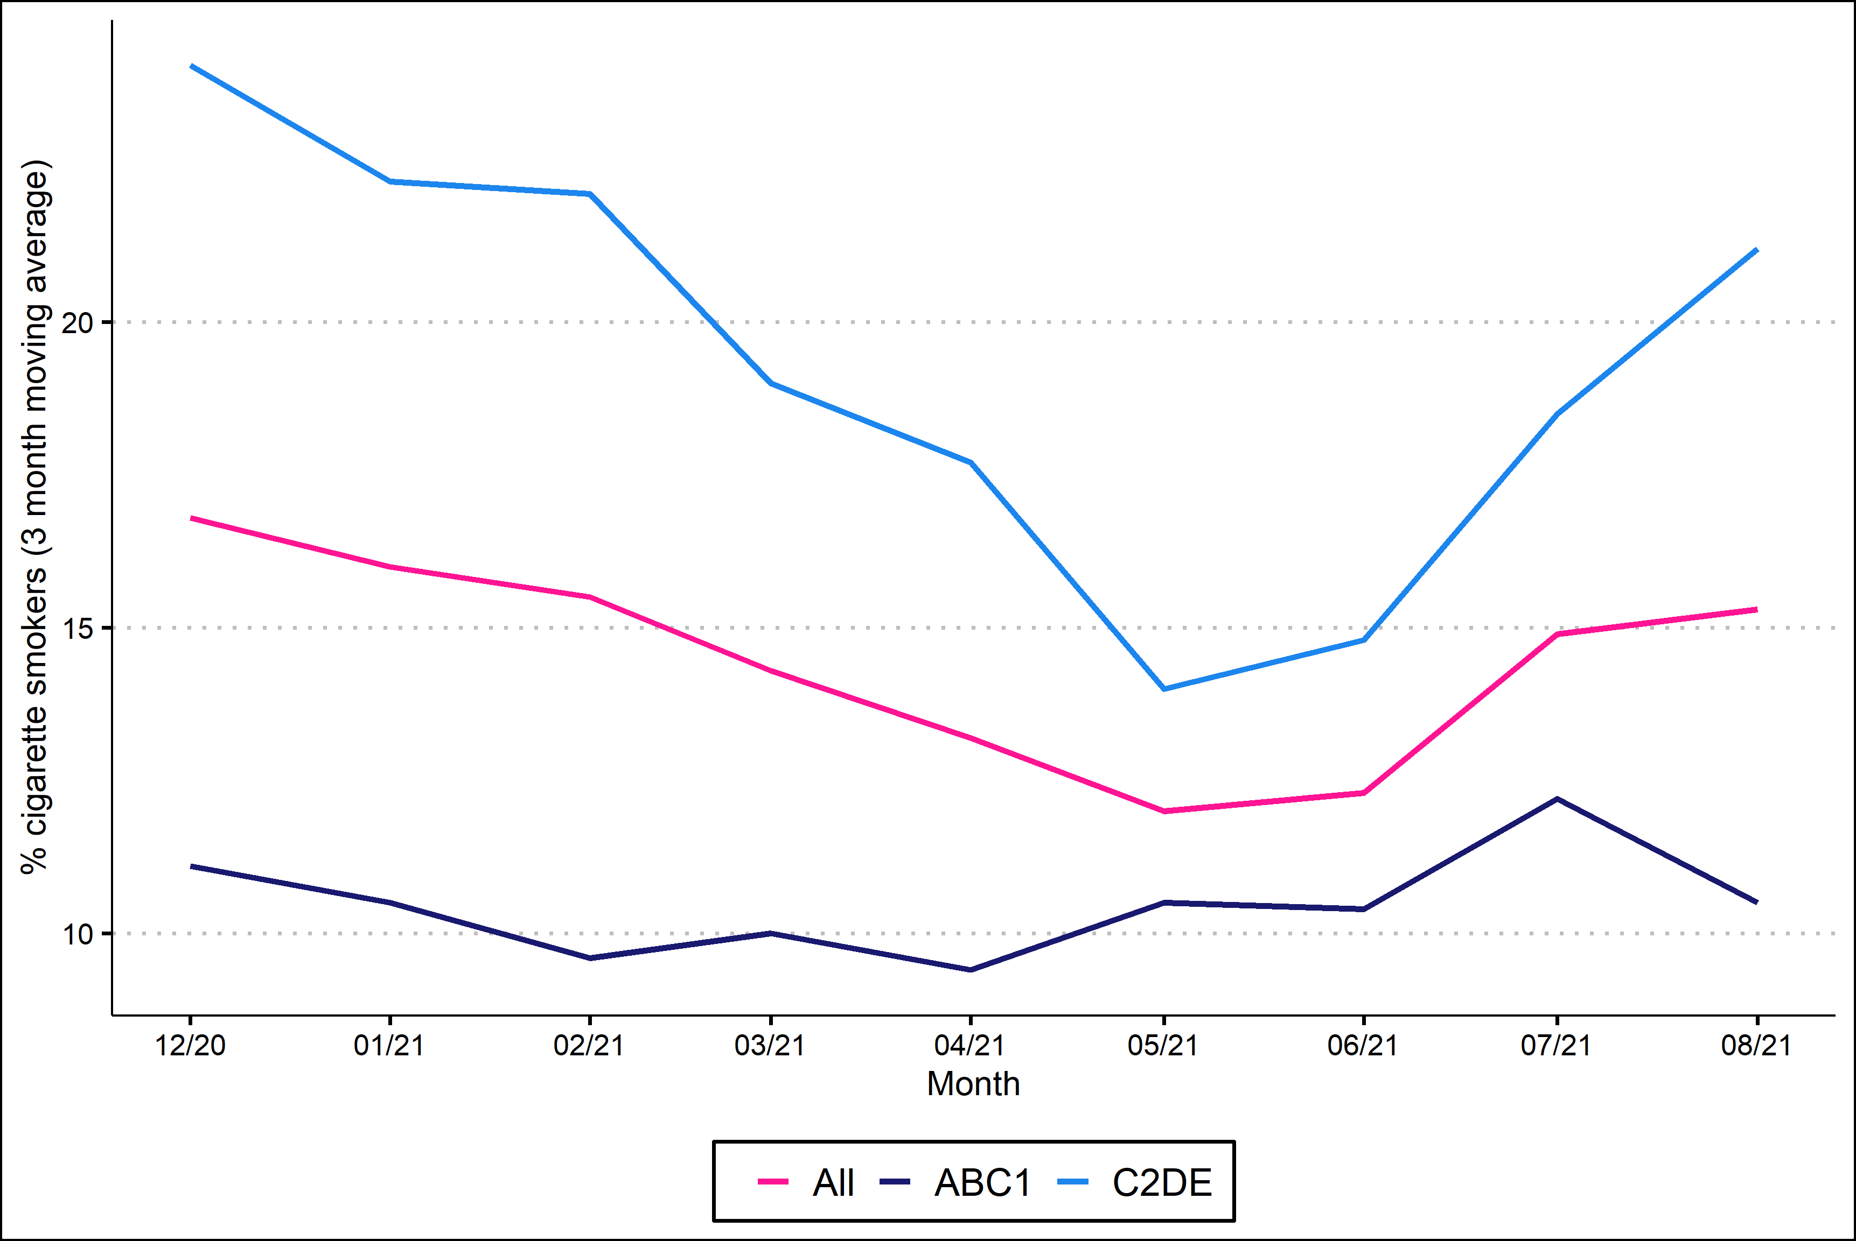
Prevalence of cigarette smoking by social grade
ABC1: Professional to clerical occupations; C2DE: Manual occupations

